Slide 1


Attrition Project
By. Mohammad Al-Rousan

Slide 2

Welcome
Hello! My name is Mohammad Al-Rousan, I am CEO and Principal Data Science Lead at Rousan Consultancy!
Notes:
I want to welcome those attending, my name is Mohammad Al-Rousan and I am the CEO and Principal Data Science Lead at Rousan Consultancy

Slide 3
Question
What factors are leading attrition in your organization?
Currently, the organization has a 16% attrition rate
Notes:
So, the purpose of today's presentation is to deliberate and come to a statistical conclusion as to your organization attrition rate, currently, the organization is experiencing a 16% attrition rate and we will break down the factor as to why

Slide 4

The Importance
Lower attrition leads to:
Better growth
Higher revenues
More demand
Notes:
The importance of discussing attrition rate, and why it is important. A potentially lower attrition rate can lead to *read out the list

Slide 5


What is the Leading factor
It’s honestly quite a very simple answer

Slide 6


Slide 7
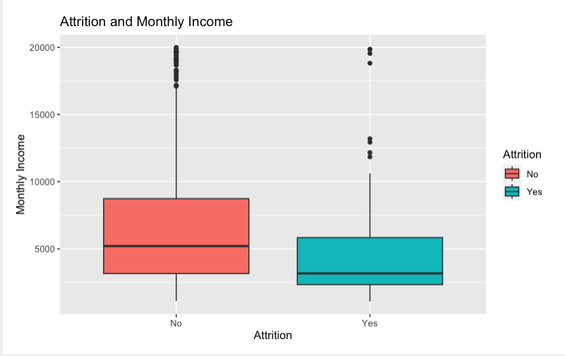

Attrition v. Monthly Income
Notes:
Monthly Income Yes 4764 and No for 6702

Slide 8
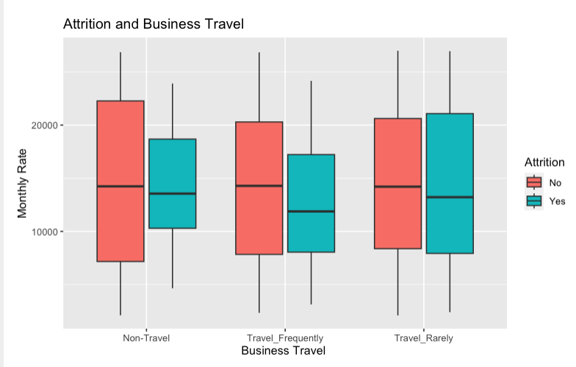
First factor
Those who travel frequently make up13.25% of those who travel but make up 28% of the 13.25% leave.
Notes:
# No Travel $14,500.78
#Travel Rarely $14,418.82
#Travel Frequently $13856.86 _Rarely6569.678

Slide 9
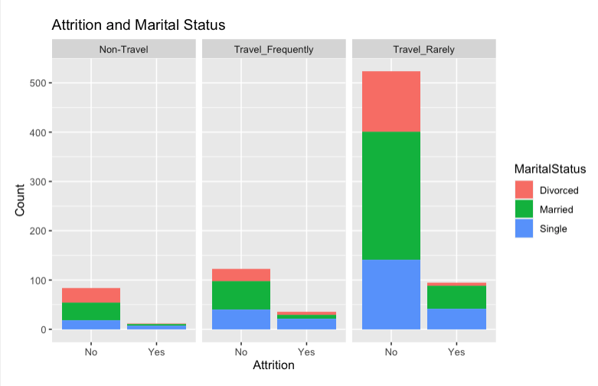
Second Factor
Now, we combine martial status and travel, and more than half those who are single who travel rarely or frequently make up more than half of those leaving.
Notes:
#The statistical summary contents that 13.25% of employees who do not travel leave, 17.93% of those who rarely travel leave, but 28.45% of those who travel frequently leave, meaning those who travel frequently for their work will have a higher chance in leaving and we will create a graph showing how does it compare to monetary value.

Slide 10
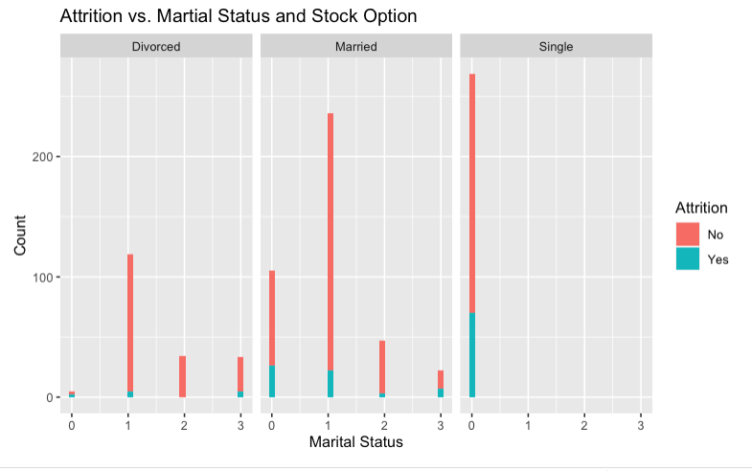
Third Factor
Those who are single, receive 0 stock option levels and it can be observed those with a certain degree of stock options will most likely stay!

Slide 11
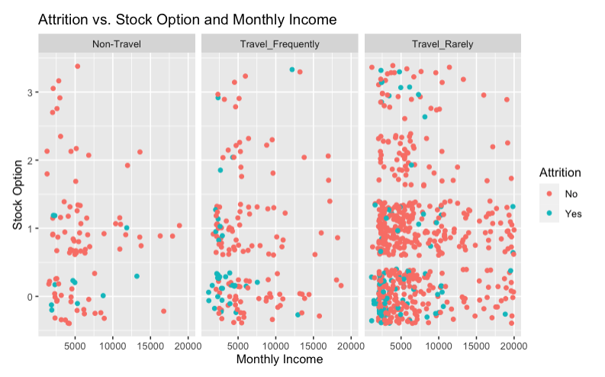
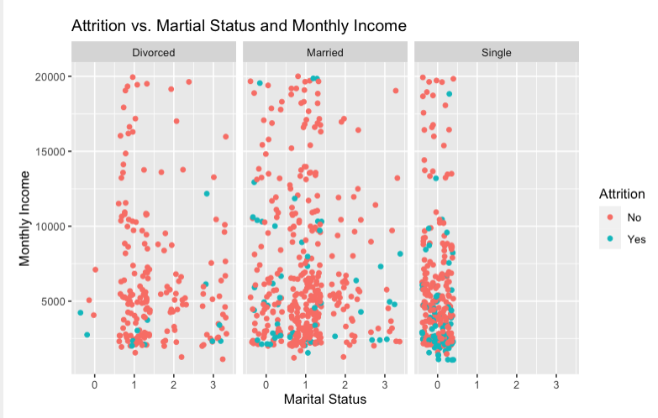
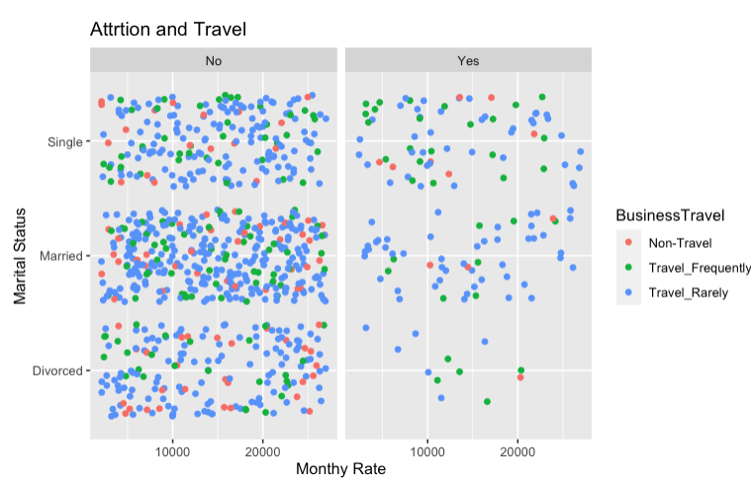
Combining it all together
Notes:
Putting it all together, the blue dots in the graph located on the left and middle, the blue dots indicate attrition and those who are single travel more frequently and earn far less as compared to those who are married or divorced and the graph on the very right shows how single people are far more likely to leave due to travel and we can observe the green dots as those who travel frequently earn less and have a higher rate of leaving

Slide 12
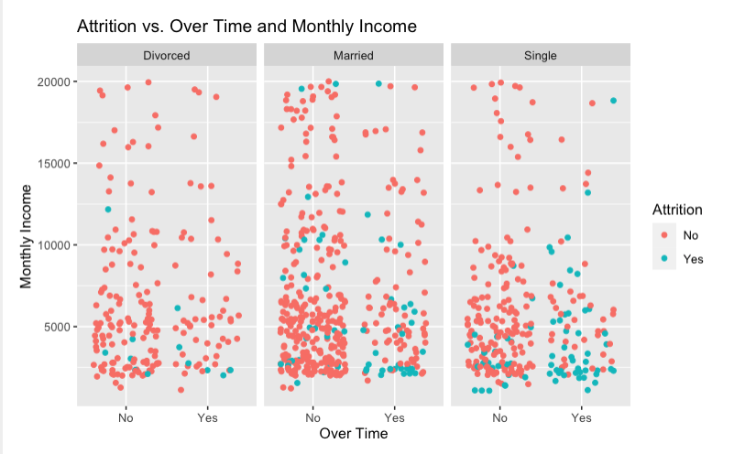
Other Factors

Slide 13
Models Ran
KNN
Naive Bayes
Linear Regression

Slide 14
KNN Model
Sensitivity 82%
Specificity 60%
Accuracy 85%

Slide 15
Naïve Bayes
Sensitivity 88%
Specificity 63%
Accuracy 92%

Slide 16

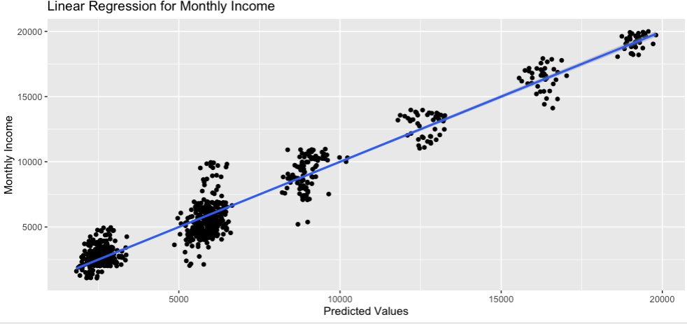

Linear Regression Model
RMSE 1378
Adjusted r Squared of .9249

Slide 17
Best Model
I believe it is the Linear Regression Model because of the Monthly income predictability, and monthly income has been proven in every graph and model with the three factors mentioned.

Slide 18
Factors used
Attrition
Monthly Income
Job Level
Job role
Age
Marital Status
Business Travel
Stock Option Level
Performance Rating
Years at company
Years Since Last Promotion
Overtime
Work Life Balance
Total years working

Slide 19
Conclusion
We know those who earn less end up leaving and the factors that lead to this conclusion is
Marital Status
Stock Options
Travel

Slide 20
Thank you for attending!
You may further reach me at:
malrousan@smu.edu
github
rshiny

